Slide 1
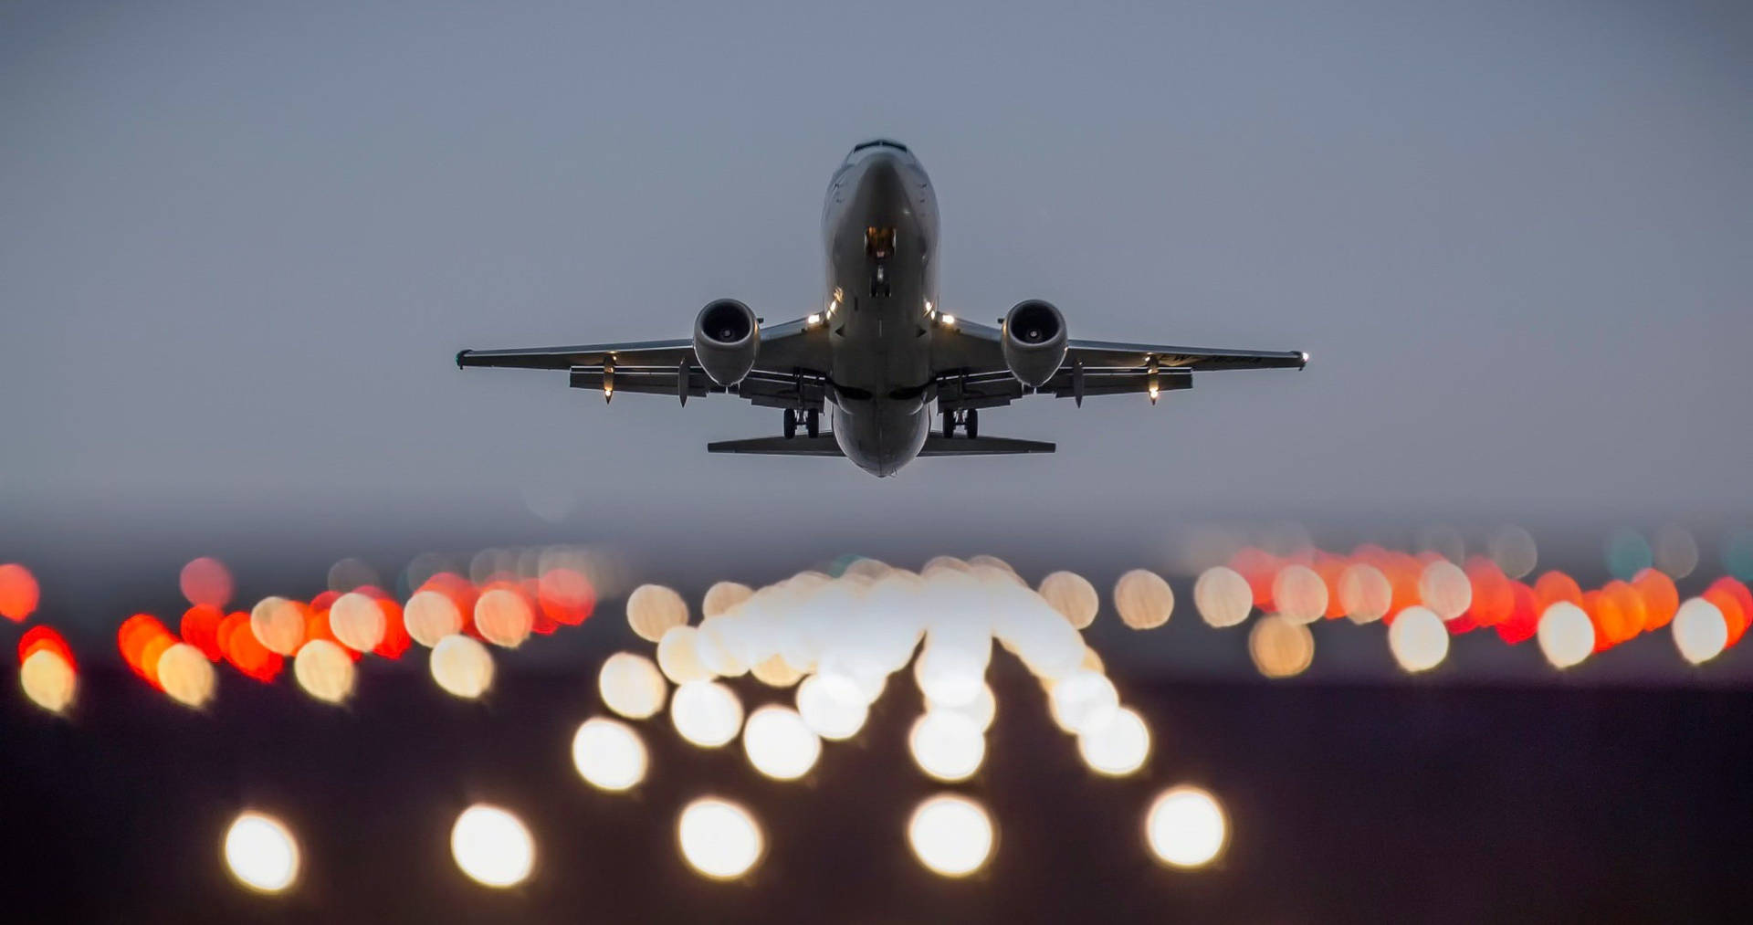
Role of Information Technology in Airline Business
Student’s Name
Student ID
Introduction to Information Technology (GEN1030)
Due Date

Slide 2
Why IT matters in airlines
Airlines use IT to sell tickets, plan flights, manage airports, support pilots, and keep passengers safe.
IT connects the full passenger journey (before, during, and after the flight).
Main systems passengers use
Airline website / mobile app
Online payment
Digital boarding pass
Real-time flight updates
Search
Book
Pay
Check-in
Board
Fly
Why airlines use IT
Faster service
Fewer errors
Better customer experience
Lower operating cost

Slide 3
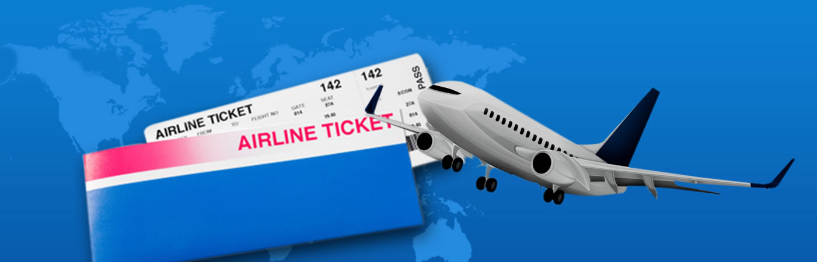
Reservations & ticketing
Computer reservation systems enable fast bookings through websites and mobile apps and wide distribution.
What IT enables
Example: SABRE
• Real-time seat availability
• Faster customer service
• Online self-booking
• Early large airline reservation system
• Built with IBM for American Airlines
• Helped scale reservations and ticketing

Slide 4
Operational and Maintenance Systems
Airlines use IT to plan and control daily operations.
These IT functions support airline operations through:
Fleet planning
Crew scheduling
Maintenance IT
• Assign aircraft to routes
• Optimize turnaround time
• Reduce delays and cancellations
• Rosters and duty limits
• Right crew at right airport
• Compliance with regulations
• Track inspections and faults
• Manage spare parts
• Improve safety and reliability

Slide 5
Flight deck & safety systems
Modern aircraft use computers to support pilots, prevent unsafe inputs, and improve the safety and reliability of flight operations.
The main computer-based safety systems used in the flight deck are:
Glass cockpit
Digital screens replace many dials
Pilot inputs become electrical signals
Recorders
Flight-data recorder
Clear flight and navigation information
Helps pilots detect issues faster
Flight control computers assist
Limits extreme commands
Fly-by-wire
Cockpit voice recorder
Used for safety investigation

Slide 6

Benefits of Information Technology in the Airline Business
Enhances customer experience through quick reservation, online check-in, in-flight live flight updates, and mobile boarding passes.
Raises efficiency of operations through automation of scheduling, reservations, and airport operations.
Improves safety and reliability with maintenance tracking systems, flight monitoring, and real-time data sharing.
Enhances improved decision-making through the use of data to optimize routes, fuel consumption, pricing and capacity planning.
Minimizes operational expenses through better use of resources, minimizing disruptions, and reducing manpower requirements.
Enhances competitiveness through enabling the airlines to respond swiftly to the demands of passengers and market changes.

Slide 7
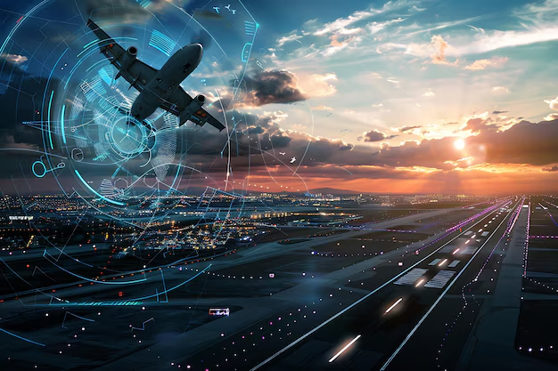
Future Perspective of IT in the Airline Industry
IT and data science will support sustainable aviation operations
Increased use of automation, AI, and machine learning
Improved fuel efficiency and reduced emissions
Better management of growing air traffic demand
Data-driven systems for air traffic management and weather integration
Optimized flight paths for efficiency and safety
Digital integration to support unmanned aircraft and urban air mobility
Support for electric aircraft and environmentally sustainable operations
IT in the Airline business is growing, but security and reliability are critical.

